Slide 1
Explicit Spatiotemporal Joint Relation Learning for Tracking Human Pose
Xiao Sun
Microsoft Research Asia
Visual Computing Group

Slide 2
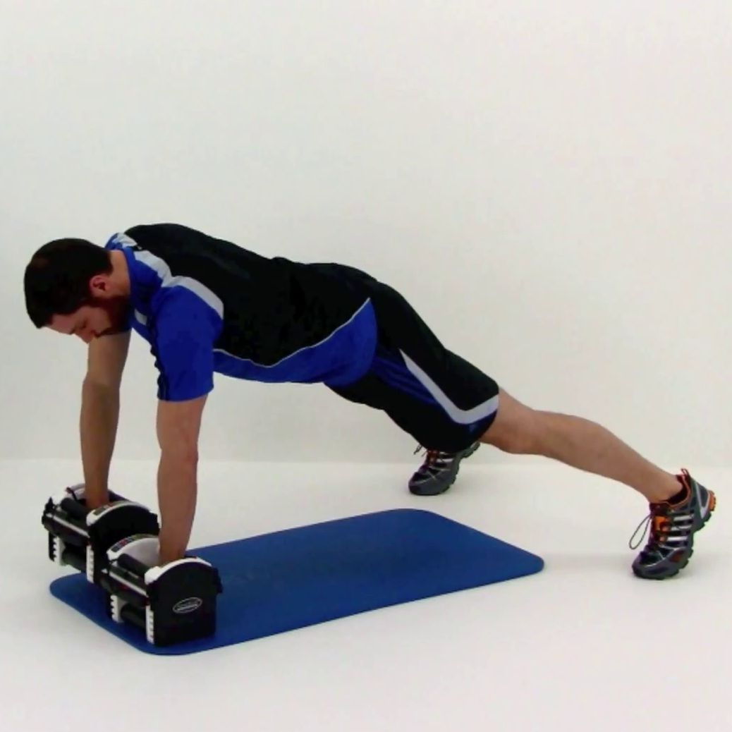
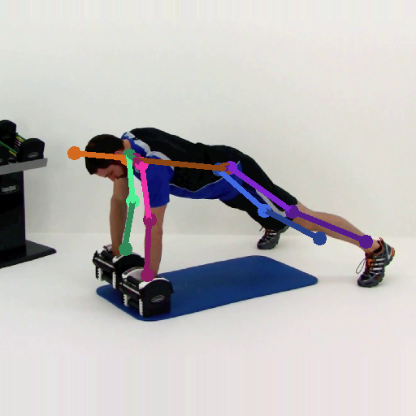
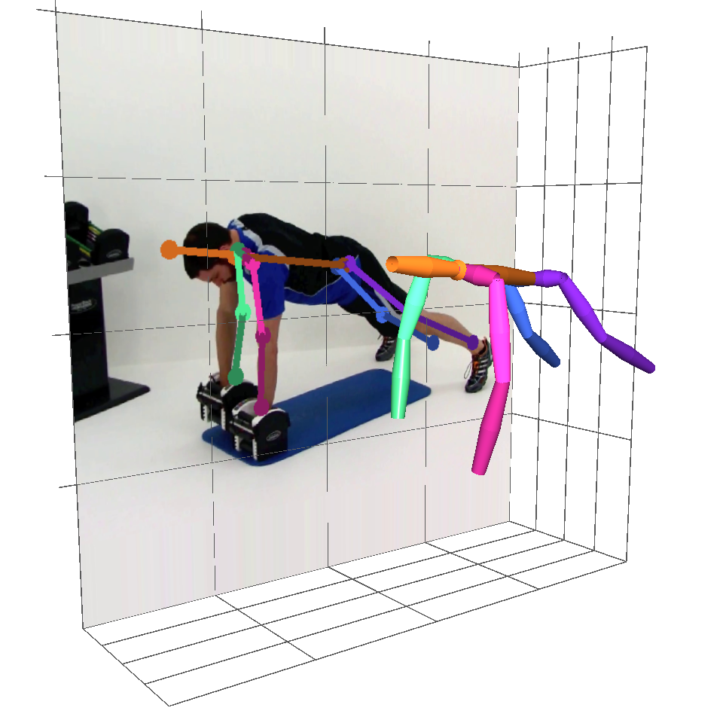
Human Pose Estimation
Problem: localize key points of a person
Input: a single RGB image
Output: 2D or 3D key points
Applications: Motion Sensing Gaming, Augmented or Mixed Reality, Action Evaluation etc.
RGB Image (person centered)
Pose Estimator
2D Key Points
3D Key Points
Notes:
The problem of human pose estimation is to localize the key points of a person.
The input is a single RGB image with a person in the image center.
Then a pose estimator is designed to output the location 2D or 3D key points of this person.
Human pose estimation is the underlying key technique for many commercial applications, such as Motion Sensing Gaming, Augmented or Mixed Reality et cetera.

Slide 3
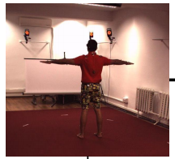
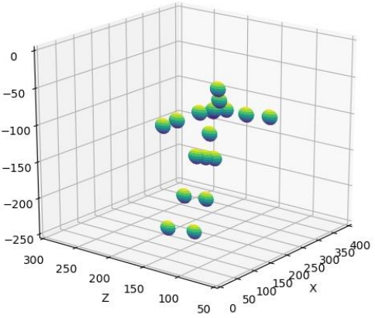
A Standard Pipeline: FCN + Heatmap Learning
Fully Convolutional Network
Joint relation in space
Joint relation in temporal
Per-pixel, per-frame, per-joint classification
A clear drawback: Joints are localized independently in each frame.
Example: where is the
left elbow?

Slide 4
Problem
How should we leverage spatiotemporal joint relation, explicitly?

Slide 5
Previous Works
How should we leverage spatiotemporal joint relation, explicitly?
Joint Structure
Temporal Information

Slide 6
Previous Works
How should we leverage spatiotemporal joint relation, explicitly?
Joint Structure
Pictorial Structures
[1] P. F. Felzenszwalb and D. P. Huttenlocher. Pictorial structures for object recognition. IJCV2005
Notes:
Optimize an objective function that includes both the unary and pairwise term

Slide 7
Previous Works
How should we leverage spatiotemporal joint relation, explicitly?
Joint Structure
Pictorial Structures
Message Passing
[2] J. J. Tompson, A. Jain, Y. LeCun, and C. Bregler. Joint training of a convolutional network and a graphical model for human pose estimation, NIPS2014

Slide 8
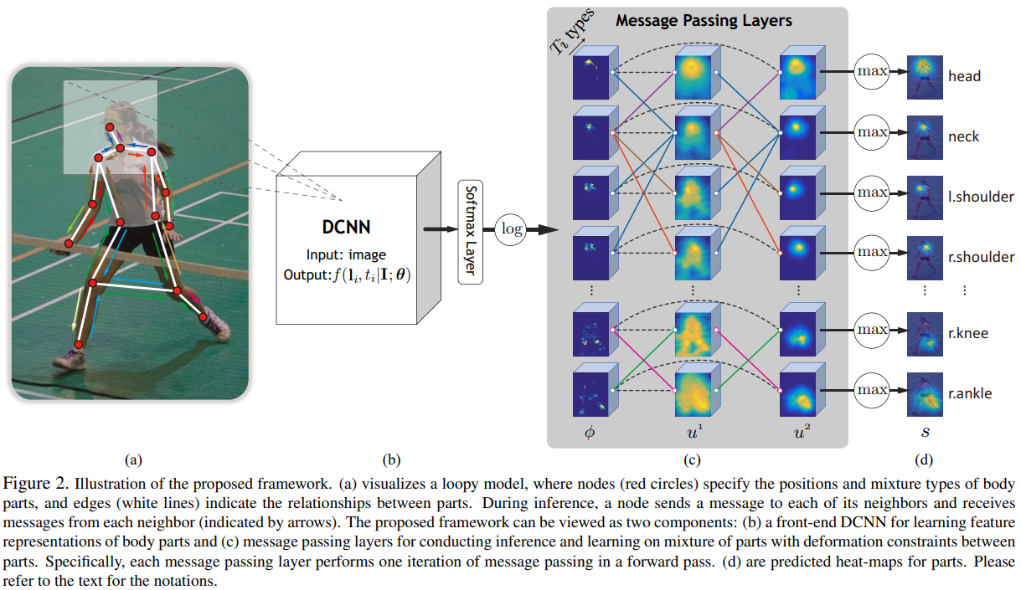
Previous Works
How should we leverage spatiotemporal joint relation, explicitly?
Joint Structure
Pictorial Structures
Message Passing
[3] W. Yang, W. Ouyang, H. Li, and X. Wang. End-to-end learning of deformable mixture of parts and deep convolutional neural networks for human pose estimation. CVPR 2016.

Slide 9
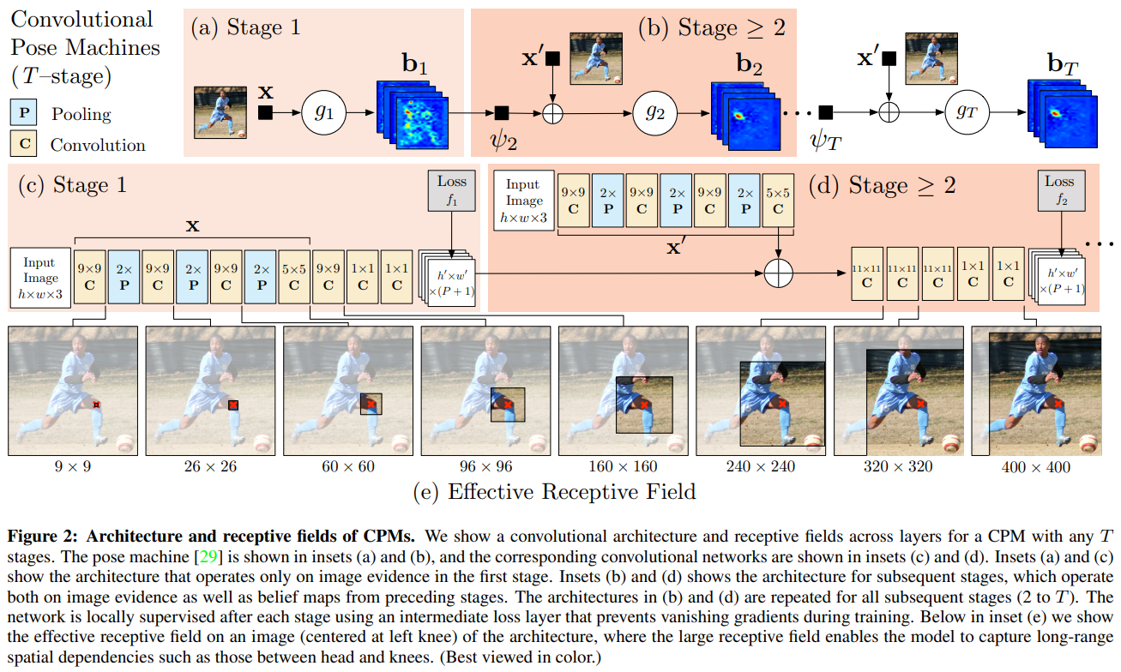
Previous Works
How should we leverage spatiotemporal joint relation, explicitly?
Joint Structure
Pictorial Structures
Message Passing
Multi-Stage Refinement
[4] S.-E. Wei, V. Ramakrishna, T. Kanade, and Y. Sheikh. Convolutional pose machines. CVPR 2016.

Slide 10
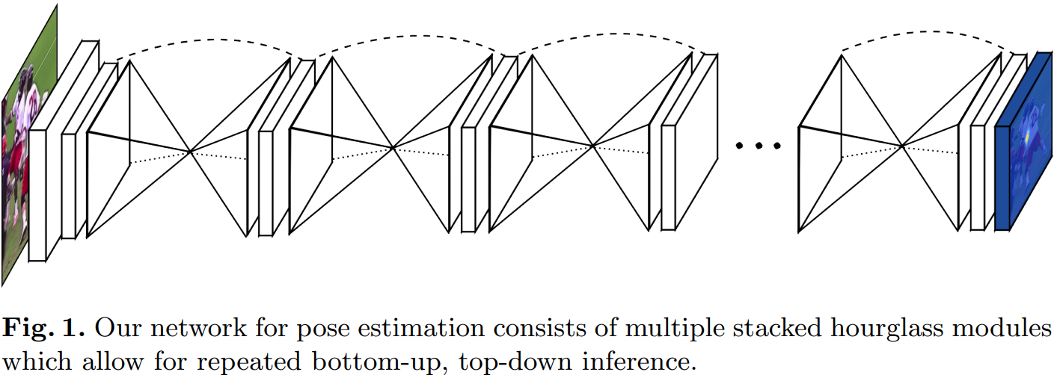
Previous Works
How should we leverage spatiotemporal joint relation, explicitly?
Joint Structure
Pictorial Structures
Message Passing
Multi-Stage Refinement
[5] A. Newell, K. Yang, and J. Deng. Stacked hourglass networks for human pose estimation. ICCV2016

Slide 11
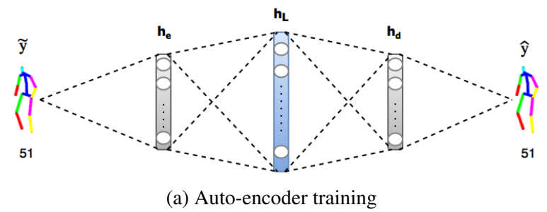
Previous Works
How should we leverage spatiotemporal joint relation, explicitly?
Joint Structure
Pictorial Structures
Message Passing
Multi-Stage Refinement
Structured Pose Parameterization
overcomplete 3D pose dictionary.
[6] B. Tekin, I. Katircioglu, M. Salzmann, V. Lepetit, and P. Fua. Structured prediction of 3d human pose with deep neural networks. BMVC 2016.

Slide 12
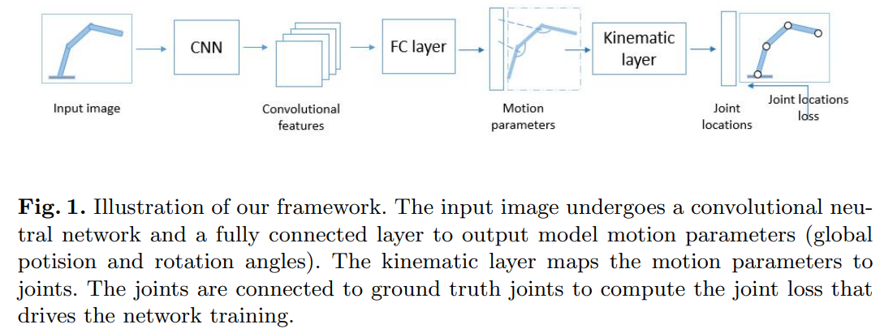
Previous Works
How should we leverage spatiotemporal joint relation, explicitly?
Joint Structure
Pictorial Structures
Message Passing
Multi-Stage Refinement
Structured Pose Parameterization
overcomplete 3D pose dictionary.
kinematic models
[7] X. Zhou, X. Sun, W. Zhang, S. Liang, and Y. Wei. Deep kinematic pose regression. ECCVW 2016

Slide 13
Previous Works
How should we leverage spatiotemporal joint relation, explicitly?
Joint Structure
Pictorial Structures
Message Passing
Multi-Stage Refinement
Structured Pose Parameterization
Geometric Loss
[8] X. Sun, J. Shang, S. Liang, and Y. Wei. Compositional human pose regression. ICCV 2017.
Notes:
For better estimation, we instead propose to use a per-pixel regression together with an attention like pixel weighting mechanism so as to take full advantage of the most relevant pixels while ignoring irrelevant ones.

Slide 14
Previous Works
How should we leverage spatiotemporal joint relation, explicitly?
Joint Structure
Temporal Information
Pictorial Structures
Message Passing
Multi-Stage Refinement
Structured Pose Parameterization
Geometric Loss

Slide 15
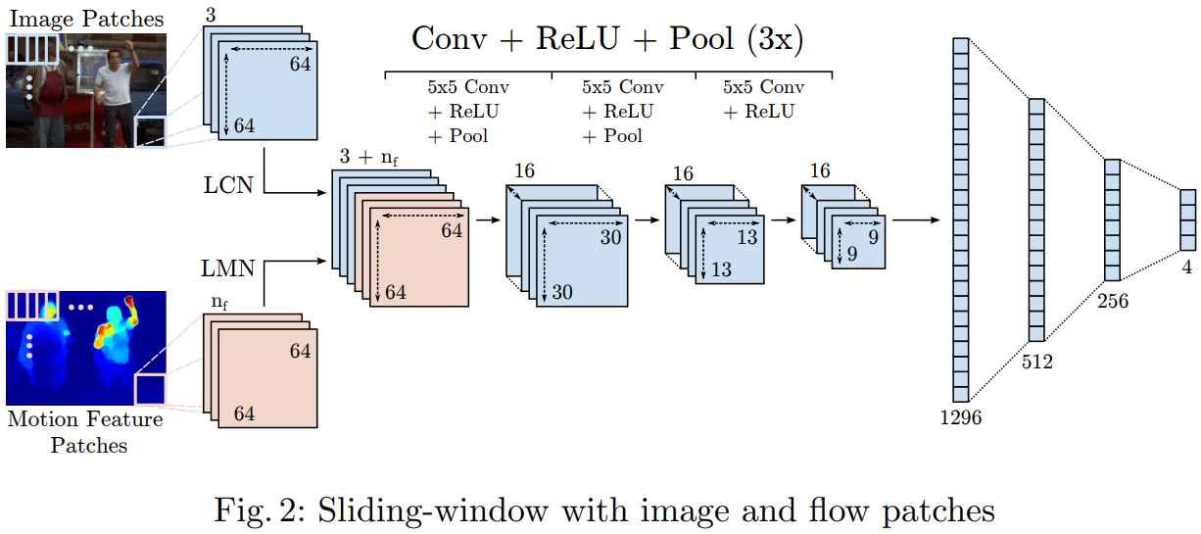
Previous Works
How should we leverage spatiotemporal joint relation, explicitly?
Temporal Information
Dense Optical Flow
[9] A. Jain, J. Tompson, Y. LeCun, and C. Bregler. Modeep: A deep learning framework using motion features for human pose estimation. ACCV 2014.

Slide 16
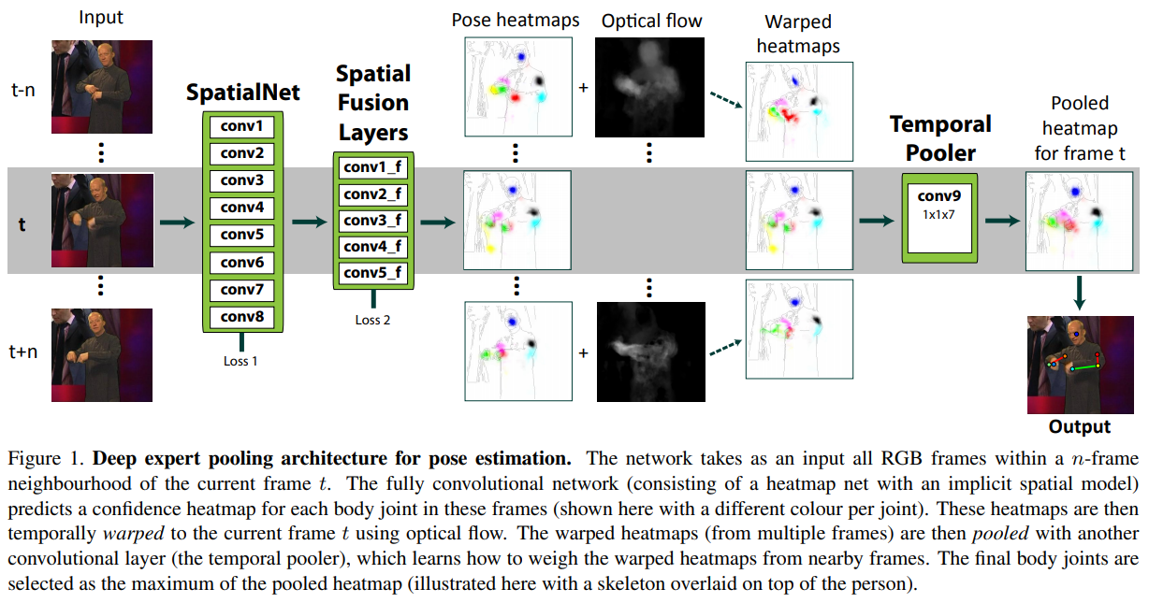
Previous Works
How should we leverage spatiotemporal joint relation, explicitly?
Temporal Information
Dense Optical Flow
[10] T. Pfister, J. Charles, and A. Zisserman. Flowing convnets for human pose estimation in videos. ICCV 2019

Slide 17
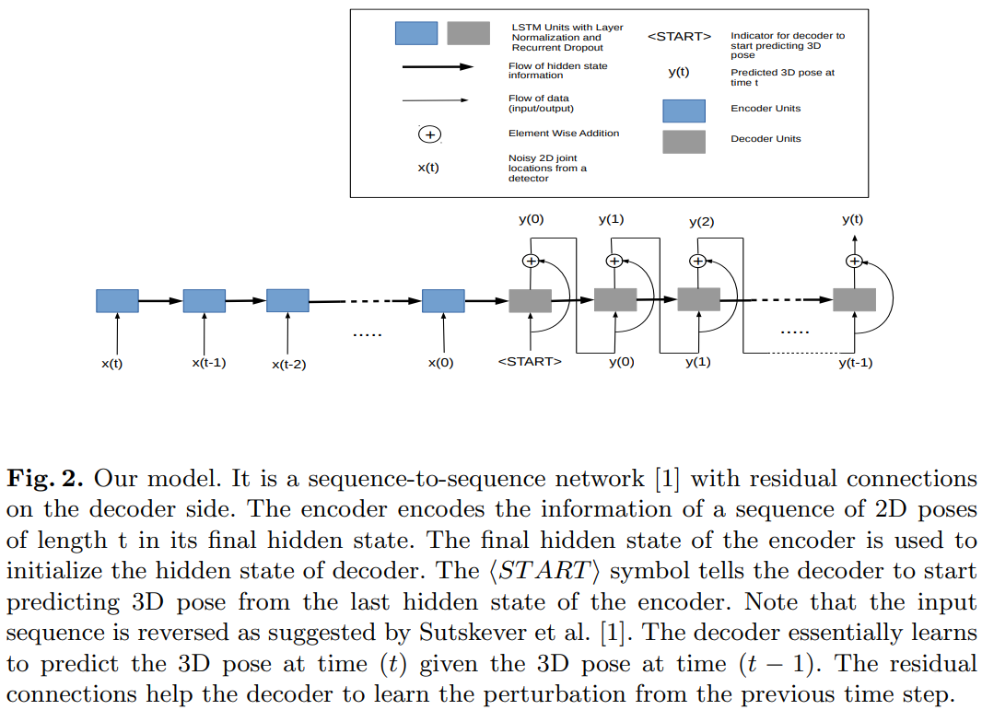
Previous Works
How should we leverage spatiotemporal joint relation, explicitly?
Temporal Information
Dense Optical Flow
Recurrent Neural Networks
[11] Rayat Imtiaz Hossain M, Little J J. Exploiting Temporal Information for 3d Human Pose Estimation. ECCV 2018.

Slide 18
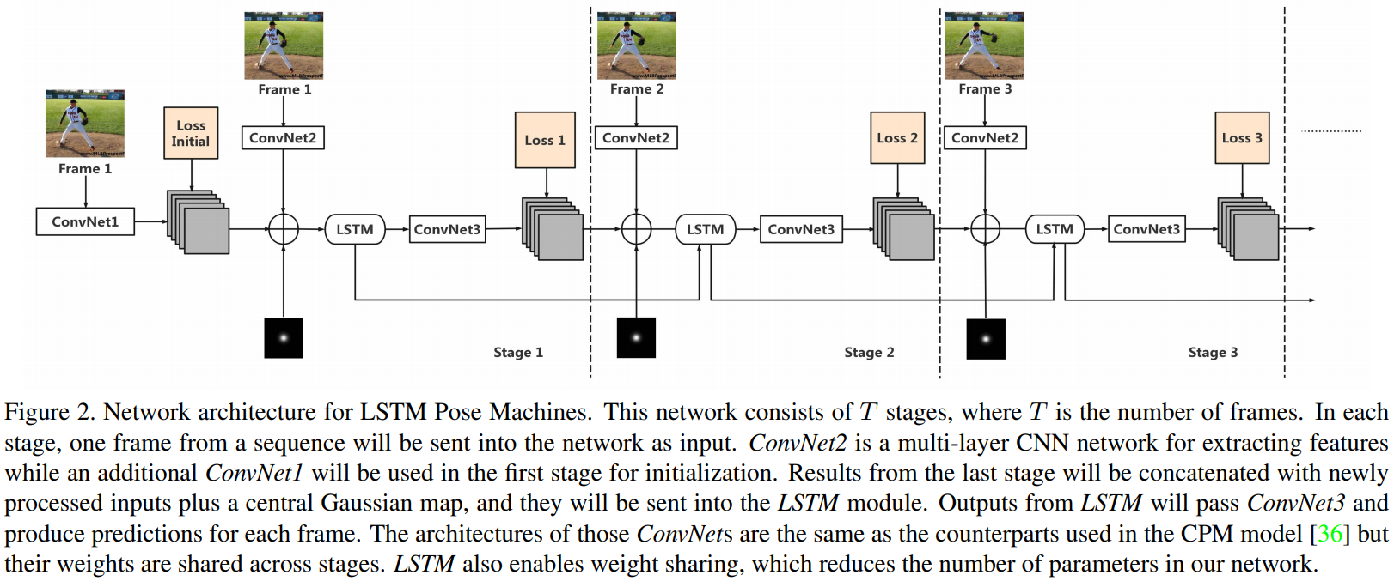
Previous Works
How should we leverage spatiotemporal joint relation, explicitly?
Temporal Information
Dense Optical Flow
Recurrent Neural Networks
[11] Luo Y, Ren J, Wang Z, et al. Lstm Pose Machines. CVPR 2018.
Notes:
In our work, we specifically train our model to predict the displacement only of human joints, with the support of information from relevant local areas. This task-specific approach provides greater reliability than generic flow, as shown empirically in Section 5.1. In addition, this approach is directly applicable to both 2D and 3D pose, while optical flow provides only 2D cues.
We seek a more targeted approach by specifically learning about human pose change.

Slide 19
Previous Works
How should we leverage spatiotemporal joint relation, explicitly?
Joint Structure
Temporal Information
Pictorial Structures
Message Passing
Multi-Stage Refinement
Structured Pose Parameterization
Geometric Loss
Dense Optical Flow
Recurrent Neural Networks
Notes:
In our work, we specifically train our model to predict the displacement only of human joints, with the support of information from relevant local areas. This task-specific approach provides greater reliability than generic flow, as shown empirically in Section 5.1. In addition, this approach is directly applicable to both 2D and 3D pose, while optical flow provides only 2D cues.
We seek a more targeted approach by specifically learning about human pose change.

Slide 20
Previous Works
How should we leverage spatiotemporal joint relation, explicitly?
Joint Structure
Temporal Information
Pictorial Structures
Message Passing
Multi-Stage Refinement
Structured Pose Parameterization
Geometric Loss
Dense Optical Flow
Recurrent Neural Networks
Explicitly model and predict the spatiotemporal joint relation.
Then, complement any single joint estimation.
Notes:
In our work, we specifically train our model to predict the displacement only of human joints, with the support of information from relevant local areas. This task-specific approach provides greater reliability than generic flow, as shown empirically in Section 5.1. In addition, this approach is directly applicable to both 2D and 3D pose, while optical flow provides only 2D cues.
We seek a more targeted approach by specifically learning about human pose change.

Slide 21
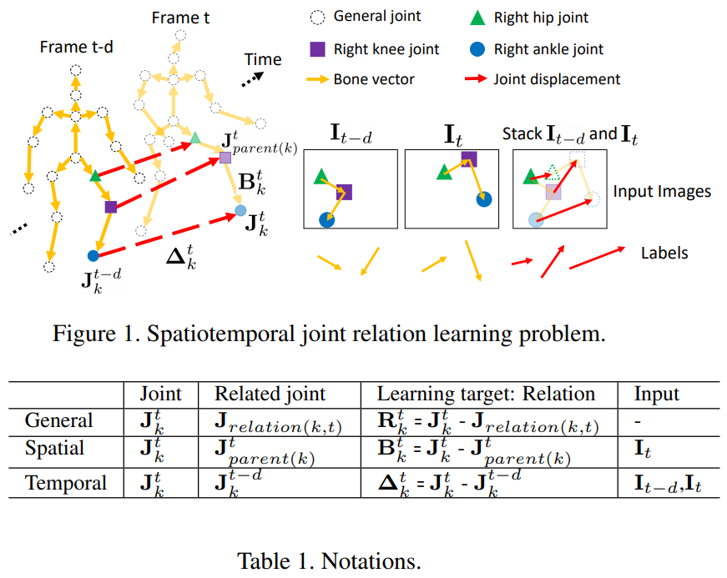
Spatiotemporal Joint Relation Learning
Spatial and Temporal Joint Relation
Target: Directed Vector Pointing from Related Joint

Slide 22
Fully Connected Regression: A Baseline
Average pooling + Fully connected layers.

Slide 23
Fully Connected Regression: A Baseline
Average pooling + Fully connected layers.
joint relations
backbone
avg pool
FCs

Slide 24
Fully Connected Regression: A Baseline
Average pooling + Fully connected layers.
A holistic mapping.
joint relations
backbone
avg pool
FCs

Slide 25
Fully Connected Regression: A Baseline
Average pooling + Fully connected layers.
A holistic mapping.
A clear drawback
Image features and outputs are fully connected, but most image areas/features are irrelevant to a specific relation.
joint relations
backbone
avg pool
FCs

Slide 26
Fully Connected Regression: A Baseline
Average pooling + Fully connected layers.
A holistic mapping.
A clear drawback
Image features and outputs are fully connected, but most image areas/features are irrelevant to a specific relation.
Solution
Holistic->Per-pixel
Averaging->Weighting
joint relations
backbone
avg pool
FCs

Slide 27
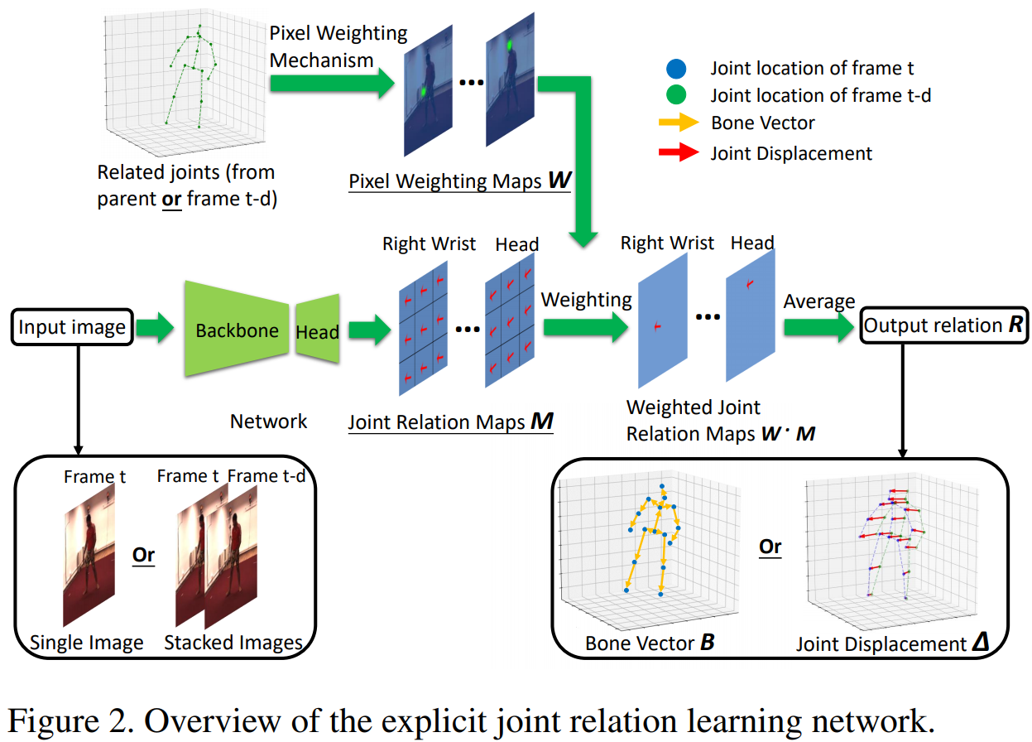
Per-pixel Regression with Attention
Joint Relation Map
Holistic->Per-pixel
Pixel Weighting Map
Ignore irrelevant pixels
Averaging->Weighting

Slide 28
Per-pixel Regression with Attention
Joint Relation Map
Holistic->Per-pixel
Pixel Weighting Map
Ignore irrelevant pixels
Averaging->Weighting
Translation augmentation

Slide 29
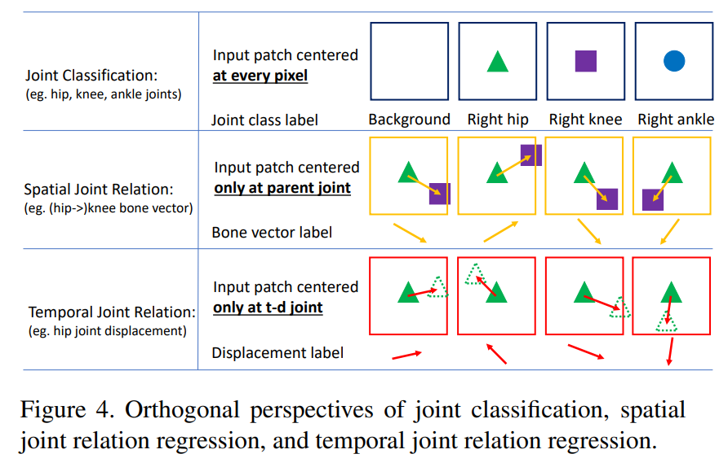
Orthogonal Perspectives
Joint Classification
Determining whether a pixel is the correct type of joint from its local image appearance
Spatial Joint Relation Regression
Predicting a child joint position conditioned on its parent joint location
Temporal Joint Relation Regression
Estimating the change in joint location based on the temporal transition.

Slide 30
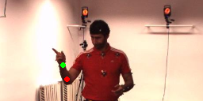
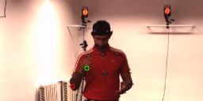
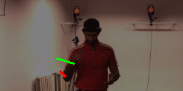
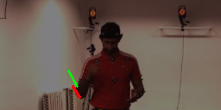
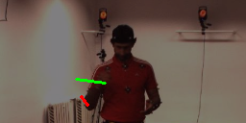
From Optical Flow to Joint Flow
Frame t-d
Optical Flow
Color Map
Frame t
FlowPD
ExplicitPD
Ground truth joint displacement
FlowPD joint displacement
ExplicitPD joint displacement

Slide 31
Spatiotemporal Joint Relations for Tracking
A simple linear optimization problem
linear least squares
(N+2)*K*T constraints, K*T unknowns
closed-form solution

Slide 32
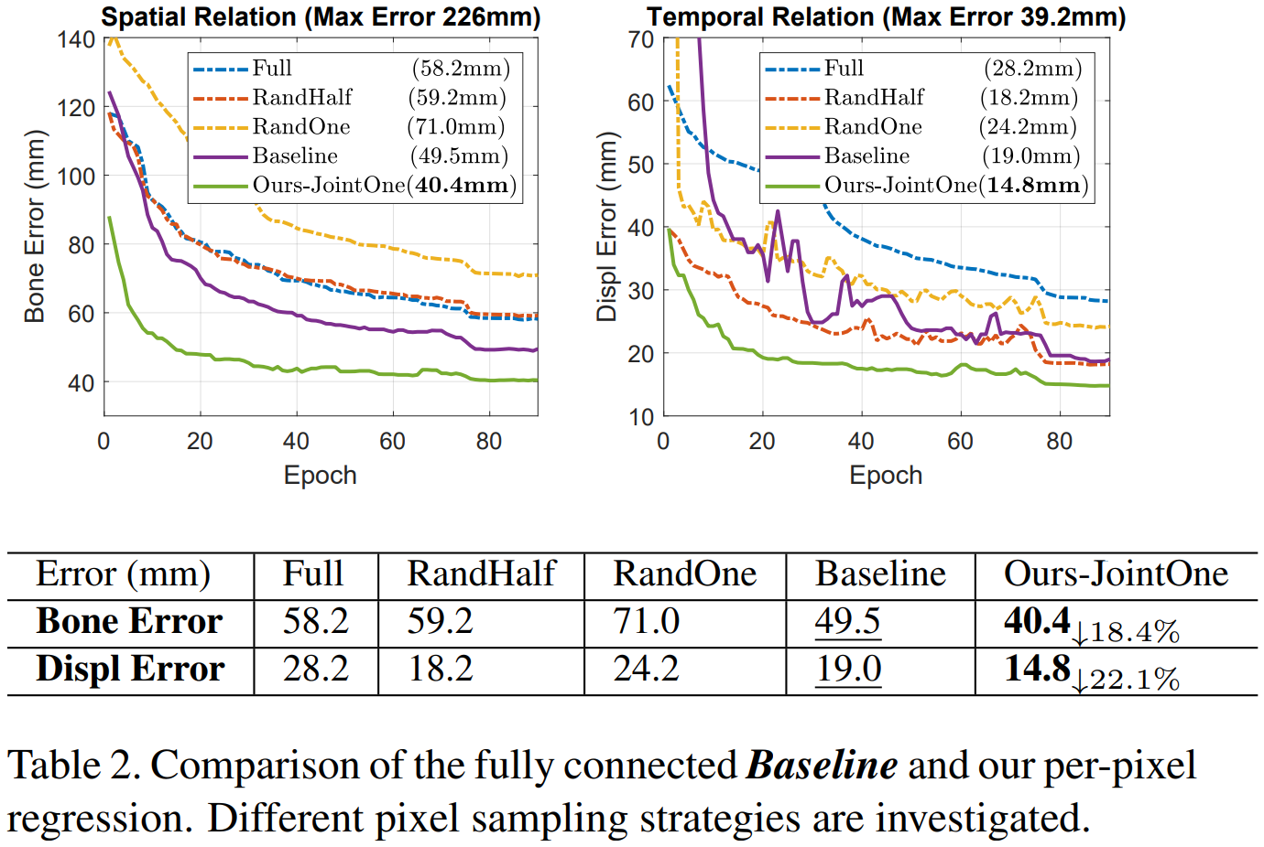
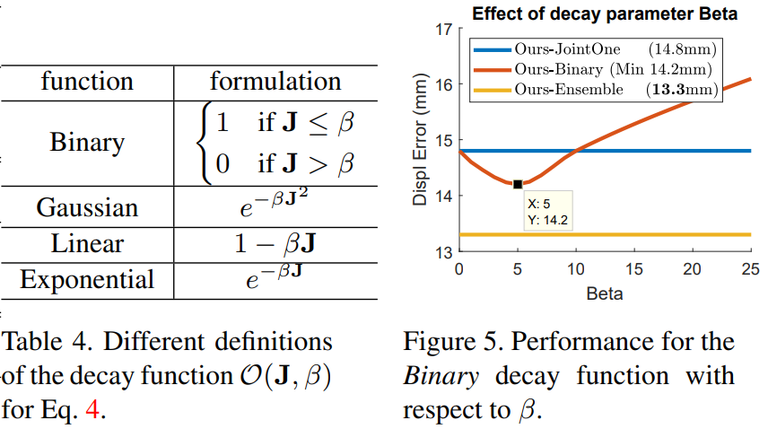
Ablation
Per-pixel regression with attention is superior to fully connected regression.

Slide 33
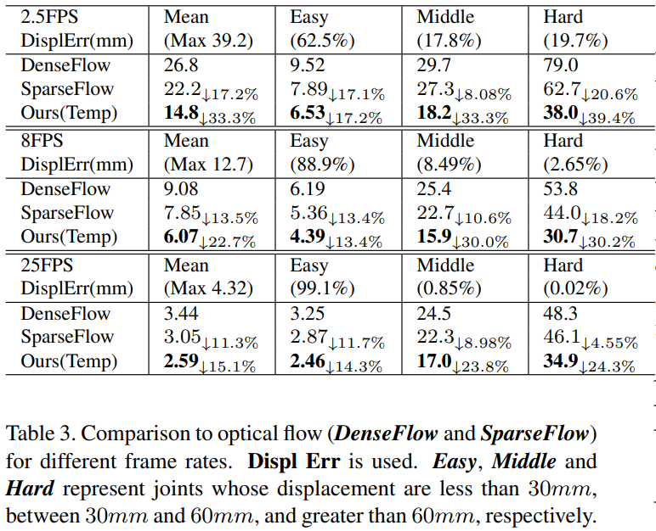
Ablation
Explicitly learned temporal joint relation is superior to optical flow.

Slide 34
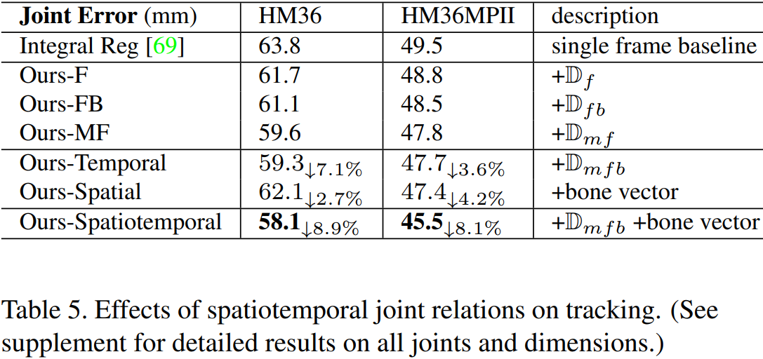
Ablation
Spatiotemporal joint relations for tracking is effective.

Slide 35
Comparison with state of the art

Slide 36
Results on MSRA Hand 2015

Slide 37
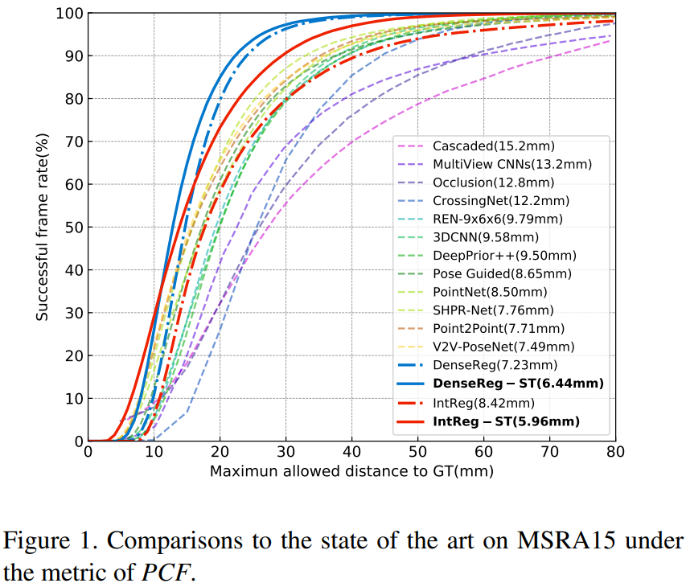
Results on MSRA Hand 2015

Slide 38
Summary
Generality
This approach can be employed for various pose tracking applications (body/hand, 2D/3D, with/without an object) and with different input modalities (RGB/depth). In our experiments, the system is demonstrated on 3D human body pose tracking in RGB video, 3D hand gesture tracking from depth sequences, and 3D hand pose tracking in RGB video.
Flexibility
The learned spatiotemporal relations are complementary not only to heatmap-based pose estimation, but also to other approaches such as local model fitting. Its speed-accuracy tradeoff is also controllable.
High performance
State-of-the-art results are obtained on standard benchmarks for the aforementioned pose tracking applications, as shown in our experiments.

Slide 39
Thanks

